Slide 1
ANF Reference Model

Slide 2
ANF Reference Model Overview
Condition
Medication Request
Vital Signs Observation
Analysis Normal Form

Slide 3
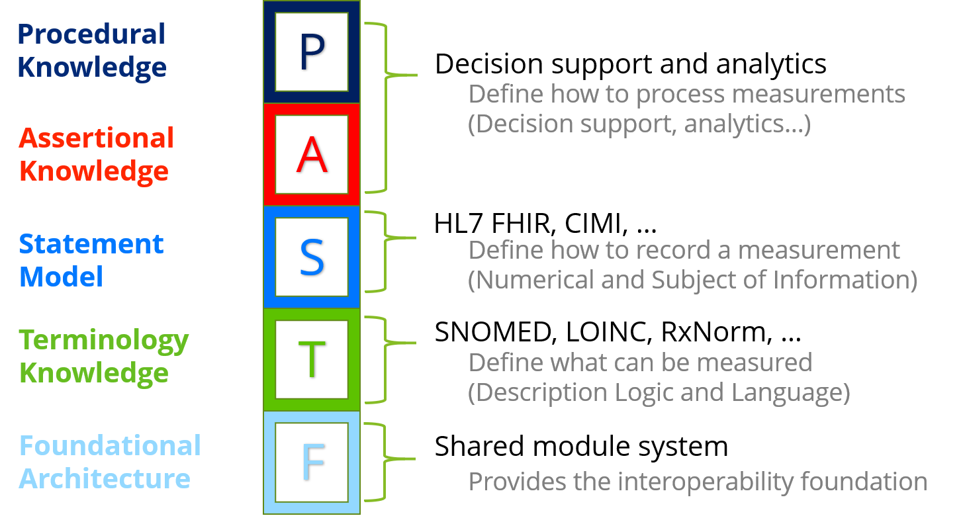
Knowledge Architecture

Slide 4
Conceptual Perspective
DAMs, Business Models, Workflows
Logical Perspective
DCMs, CIMI, ANF
Implementable Perspective
Implementation Guides, Profiles, Reference Implementations

Slide 5
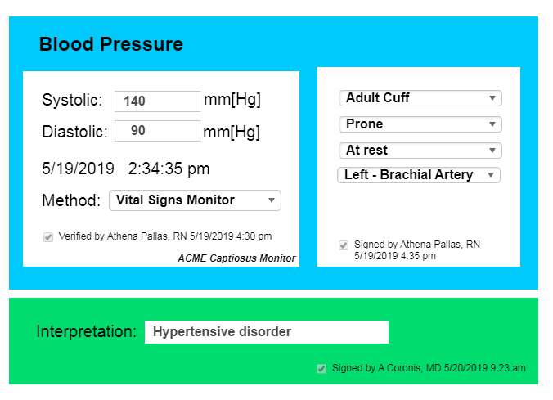
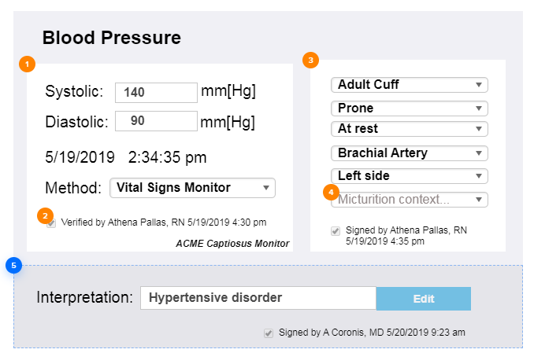
Source of standards-based clinical statement
EHR 1
EHR 2
Clinical Input/Display Format
FHIR resources/CDA docs/V2 messages
FHIR resources/ CDA docs/ V2 messages
Analysis Repository (FHIR API)
FHIR ANF –based query
Clinical Decision Support

Slide 6


Assessment
Questionnaire
FHIR resources/CDA docs/V2 messages
FHIR resources/ CDA docs/ V2 messages
ANF statements
derived from assessment questionnaire
Analysis Repository
FHIR API – using ANF

Slide 7



EHR System
FHIR resources/CDA docs/V2 messages
FHIR resources/ CDA docs/ V2 messages
Analysis Repository (FHIR API)
FHIR ANF –based query
Clinical
Decision Support

Slide 8
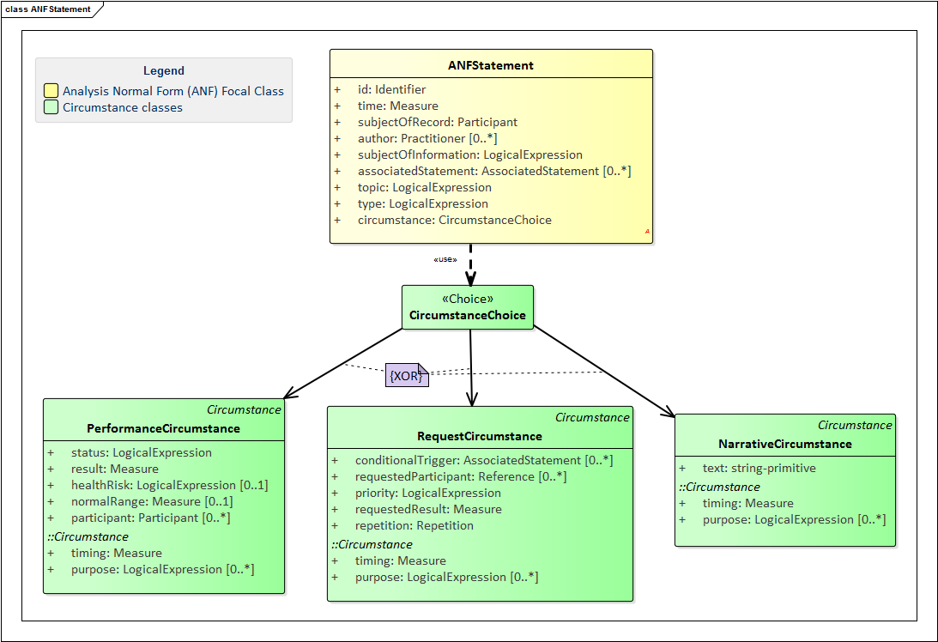
“circumstance” choice
Exclusive OR
Base class
Inherited attributes

Slide 9
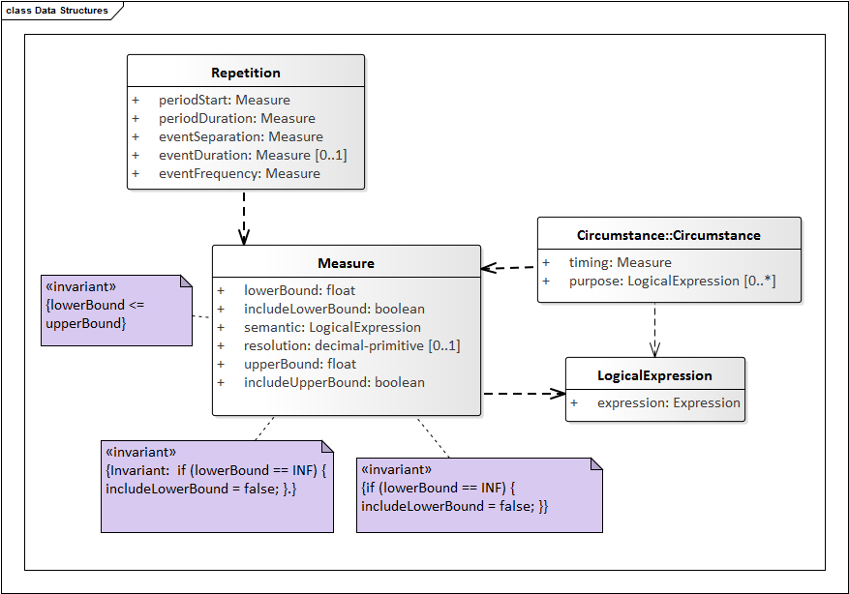
ANF Building Blocks

Slide 10
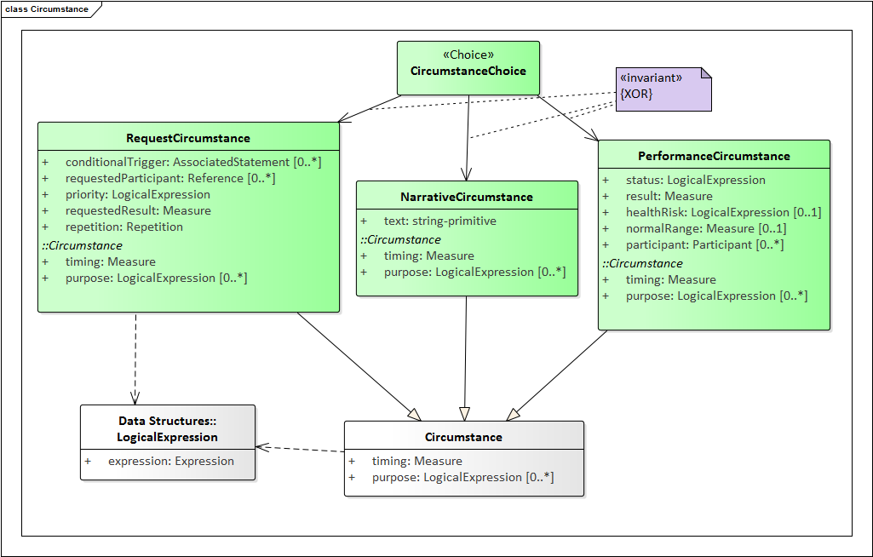
ANF Polymorphic Structures: Circumstance

Slide 11
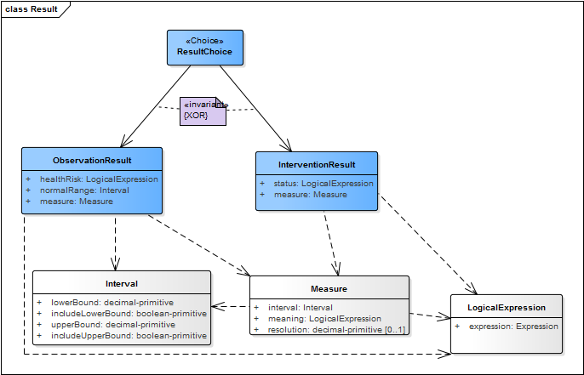
Example: Order Vital Signs Exam

Slide 12
Example: Order vital signs exam
Statement → Request → Observation Result

